Slide 1
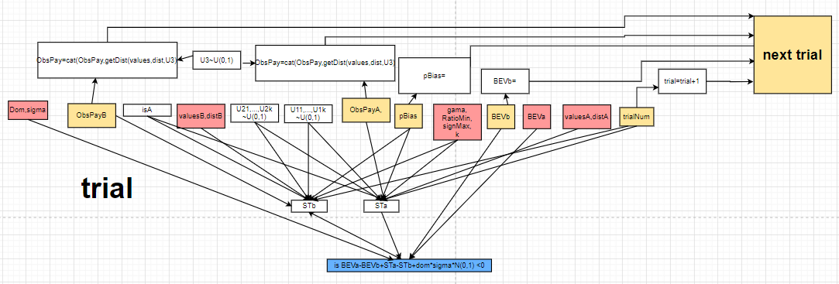

Slide 2
def Decision(BEVb, BEVa, kapa, pBias, trial, SignMax, RatioMin, gama, Range, valuesA, distA, ObsPayA, MinA, valuesB,
pEstB, ObsPayB, MinB, Outcome, Dom, sigma):
STa = 0
STb = 0
for s in range(kapa):
rndNum1 = torch.rand(size=(1,))
rndNum2 = torch.rand(size=(1,))
STa = STa + Outcome(pBias, trial, SignMax, RatioMin, gama,
Range, valuesA, distA, ObsPayA, rndNum1, rndNum2, MinA)
STb = STb + Outcome(pBias, trial, SignMax, RatioMin, gama,
Range, valuesB, pEstB, ObsPayB, rndNum1, rndNum2, MinB)
STa = STa / kapa
STb =STb/ kapa
return F.tanh(BEVa - BEVb + STa - STb + Dom * sigma * torch.normal(0, 1))

Slide 3
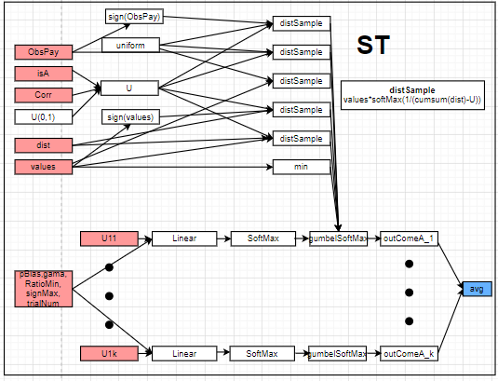

Slide 4
class Outcome(torch.nn.Module):
def __init__(self):
super(Outcome, self).__init__()
def forward(self, pBias, trial, SignMax, RatioMin, gama,Range, values, dist, ObsPay, rndNum1, rndNum2, Min):
Unbiased1 = distSample(values, dist, rndNum2)
Unbiased2 = distSample(ObsPay, Uniform(ObsPay), rndNum2)
Pessimism1 = Min
Pessimism2 = distSample(values, Uniform(values), rndNum2)
Sign1 = Range * distSample(F.softsign(values), dist, rndNum2)
Sign2 = Range * distSample(F.softsign(ObsPay), Uniform(ObsPay), rndNum2)
if rndNum1 > pBias and trial < 5
return Unbiased1
elif rndNum1 > pBias:
return Unbiased2
elif rndNum1 > (2 / 3) * pBias:
return Pessimism2
elif rndNum1 > (1 / 3) * pBias and SignMax > 0 and RatioMin < gama:
return Pessimism1
elif rndNum1 > (1 / 3) * pBias:
return Pessimism2
elif trial < 5:
return Sign1
else:
return Sign2

Slide 5
class Outcome(torch.nn.Module):
def __init__(self):
super(Outcome, self).__init__()
self.Linear = torch.nn.Linear(6, 6)
self.LogSoftMax = torch.nn.LogSoftmax()
def forward(self, pBias, trial, SignMax, RatioMin, gama,Range, values, dist, ObsPay, rndNum1, rndNum2, Min):
Unbiased1 = distSample(values, dist, rndNum2)
Unbiased2 = distSample(ObsPay, Uniform(ObsPay), rndNum2)
Pessimism1 = Min
Pessimism2 = distSample(values, Uniform(values), rndNum2)
Sign1 = Range * distSample(F.softsign(values), dist, rndNum2)
Sign2 = Range * distSample(F.softsign(ObsPay), Uniform(ObsPay), rndNum2)
output=torch.cat((Unbiased1,Unbiased2,Pessimism1,Pessimism2,Sign1,Sign2))
input=torch.cat((pBias, trial, SignMax, RatioMin, gama,rndNum1))
oneHot=F.gumbel_softmax(self.LogSoftmax(self.Linear(input)),hard=True,tau=0.01)
return torch.reshape(torch.matmul(oneHot,output),(1,))

